Slide 1
Image Dehazing using Improved Dark Channel Prior and Relativity gaussian
Presented by:
KUMAR KASHYAP
RAKESH KUMAR SINGH
RAUSHAN KUMAR
OMAR FARAHAN MOLLA
Notes:
Delete this slide when you finish preparing the other slides.

Slide 2
Contents
Introduction
Methodology
Algorithm Analysis
Experiments & Result
Conclusion

Slide 3
Introduction
In This presentation we’ll discuss about “Image Dehazing using Improved Dark Channel Prior and Relativity gaussian”.
Let’s know about Image. An image is a picture that has been created or copied and stored in electronic form.
Now, What is Hazy Image? Haze is a main degradation of outdoor images, weakening both colors and contrasts. It is based on a key observation - most local patches in outdoor haze-free images contain some pixels whose intensity is very low in at least one-color channel.
In short, Image dehazing aims to recover the uncorrupted content from a hazy image.
Here we’ll recover the content from a hazy image by using Dark Channel Prior and Relativity gaussian
The Dark channel prior is a kind of statistics of outdoor haze-free images. Dark Channel Prior used by “Kaiming He” for single image dehazing. His observation revealed that, at least one color channel of an RGB image has some pixels of lowest intensities, which tends to zero.

Slide 4
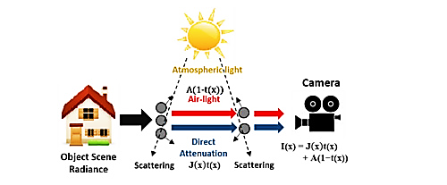
Introduction(cont.)
Sources of Hazy image distortion are:
1. Light Scattering: The absorption and/or scattering of natural light due to atmospheric particles present as a result of air pollution, varied weathers and water droplets causing mist, fog, haze in most parts of the world, lowers contrast of the images mostly captured in the outdoors and appear dimmer.
2. Color Change: Color change leads to the varying degrees of attenuation.

Slide 5
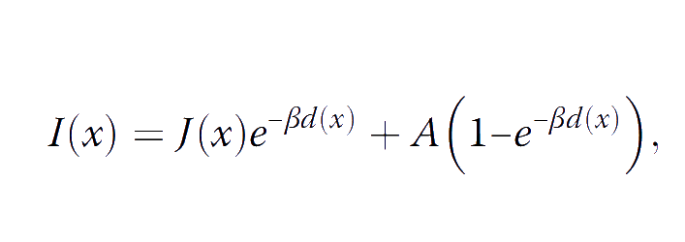
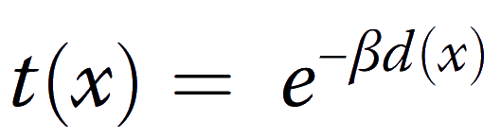
Dark channel prior based image dehazing
It has different models. Let’s discuss about its various models:
Degradation model: Using hazy image formation model, image formed at camera can be given as:
x represents the image coordinates
I is the observed hazy image
J is the haze-free image
A is the global atmospheric light
β is the scattering coefficient of the atmosphere
d is the scene depth
Here, e− βd is often represented as the transmission map and is given by:

Slide 6
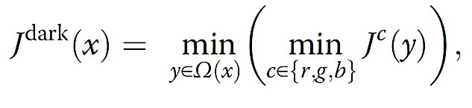
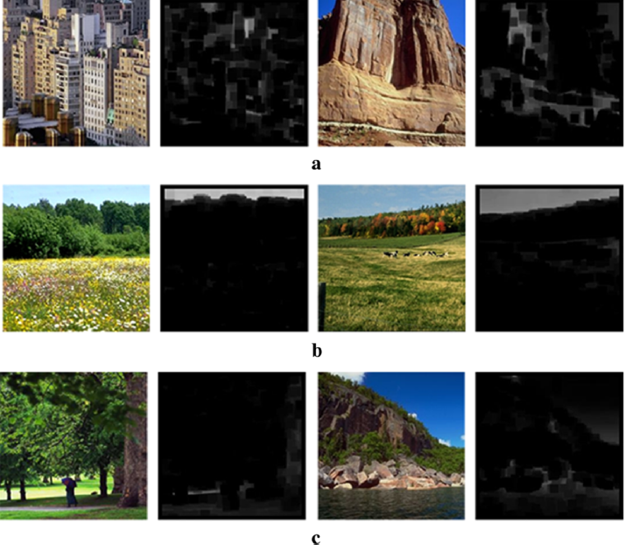
Dark channel prior based image dehazing(cont.)
Dark channel prior (DCP): There are dark pixels whose intensity values are very close to zero for at least one color channel within an image patch. Based on this observation, a dark channel is defined as follows:
Jc is an intensity for a color channel c ∈ {r, g, b} of the RGB image
Ω(x) is a local patch centered at pixel x
The minimum value among the three color channels and all pixels in
Ω(x) is chosen as the dark channel Jdark(x)
In the given figure: (a) the shadows of buildings and rocks
(b) colorful flowers and scenes
(c) tree trunks and stones

Slide 7
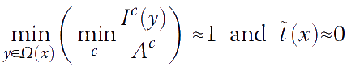
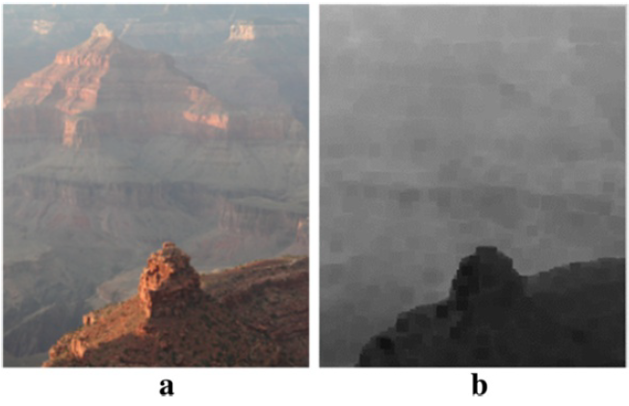
Dark channel prior based image dehazing(cont.)
DCP-based image dehazing: DCP-based dehazing algorithm is:
The dark channel is first constructed from the input image.
The atmospheric light and the transmission map are then obtained from the dark channel.
The transmission map is further refined, and the haze-free image is finally reconstructed.
Hazy image
Dark channel of (a)

Slide 8
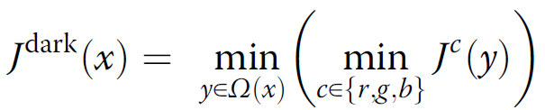
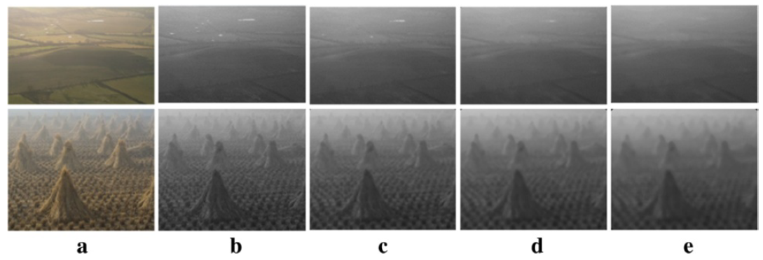
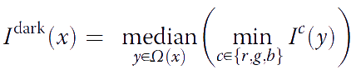
Analysis of DCP-based dehazing algorithms
Previously, we reviewed the original DCP-based dehazing algorithm. Instead of analyzing each method individually, we classify all the methods in accordance with the four steps of image dehazing and then perform a step-by-step analysis.
Dark channel construction: Most conventional DCP-based dehazing methods estimate the dark channel from the input hazy image I.
In the given equation, the size of the local patch Ω(x) is the only parameter that needs
to be determined. Although the effect of the size of the local patch is significant, most conventional methods simply use a local patch with a fixed size or do not specify the size of the local patch.
The median operator as follows: (a) Hazy images
Dark channels obtained
with the patch size of
(b)3 × 3, (c) 7×7,
(d) 11 × 11, (e) 15×15

Slide 9
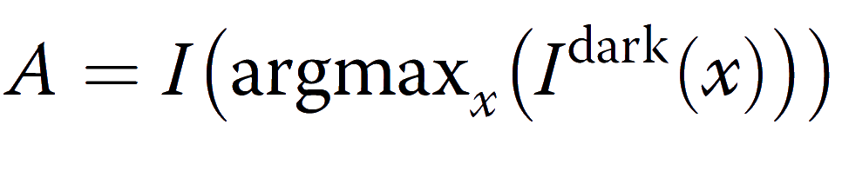
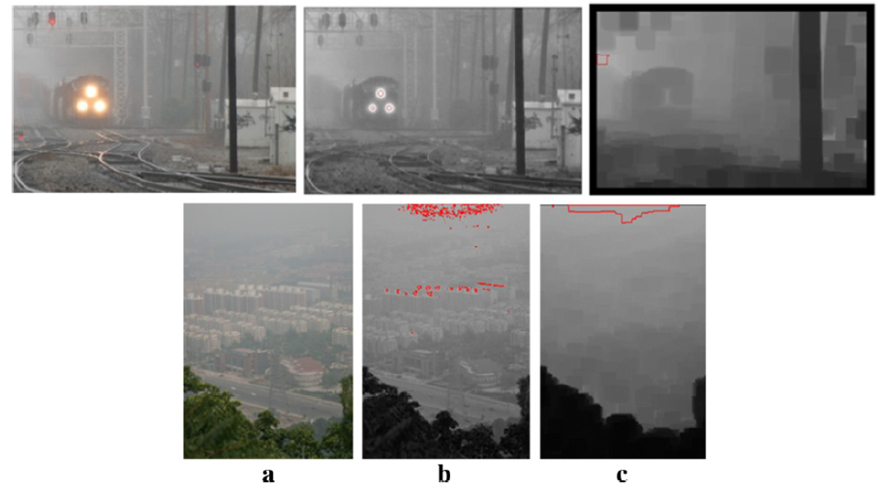
Analysis of DCP-based dehazing algorithms(cont.)
Atmospheric light estimation: The majority of conventional DCP-based dehazing methods estimate A as described in previous, the pixel with the highest dark channel value is used directly as follows:
Atmospheric light estimation. (a) Hazy image.
The pixels in the dark channel that are used
to estimate the atmospheric light when the
size of Ω is (b) 3 × 3 and (c) 32×32

Slide 10
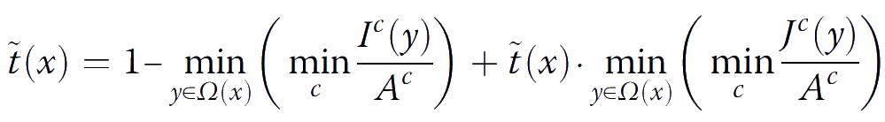
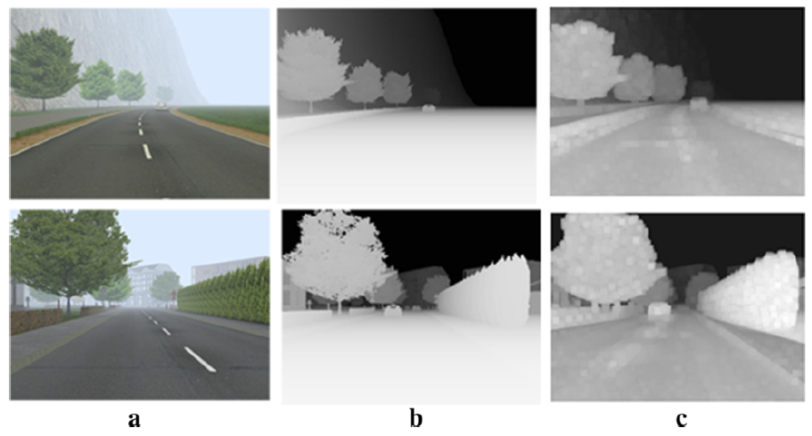
Analysis of DCP-based dehazing algorithms(cont.)
Transmission map estimation: The transmission map is obtained from the DCP. If the DCP is not exploited, can
be rewritten as:
Hazy images and ground-truth and estimated
transmission maps
(a) Hazy images.
(b) Ground-truth transmission maps,
where A = [220,235,254] and β = 0.01.
(c) Transmission maps obtained

Slide 11
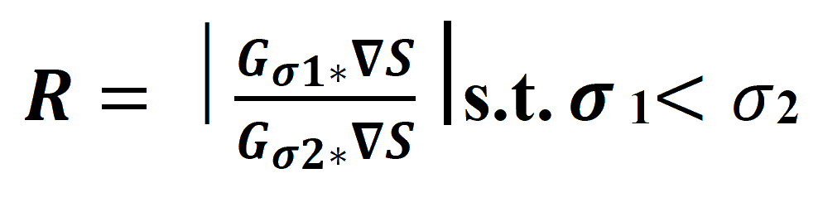
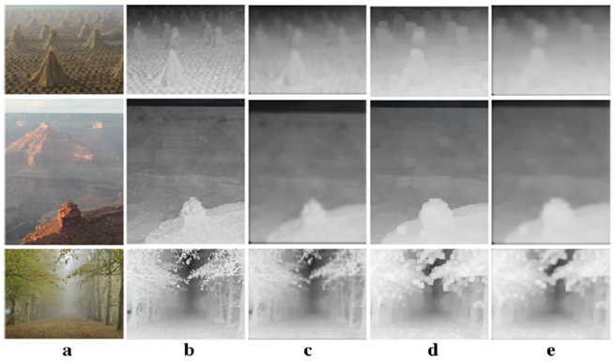
Analysis of DCP-based dehazing algorithms(cont.)
Transmission Map Enhancement: In proposed system, we use guided filter and Relativity of Gaussian for enhancement of transmission map.
Relativity of Gaussian (RoG): Relativity of Guassian can be applied to hazy images for detail enhancement. We adopt detail improvement based on Relativity of Gaussian (RoG) to boost the structure and details within the image while preserving the edges.
[𝜎1 and 𝜎2 are two parameters]
The result of the Gaussian filter.
(a) Hazy images, b Transmission map obtained using the local patch,
(c) Gaussian filtered transmission map,
(d)Transmission map obtained using the local patch,
(e) Gaussian filtered transmission map

Slide 12
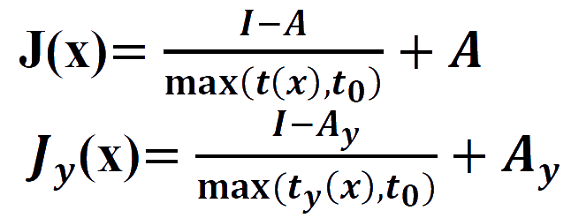
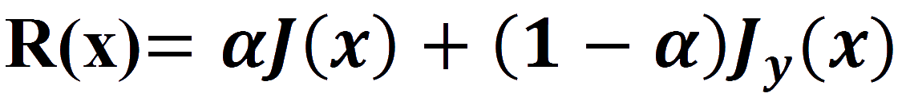
Experiments & Result
Reconstruction of Haze Free Image: In final stage after computing all the parameters is to reconstruct the improved image with minimized haze influence. The image reconstruction process is given:
quality
where 𝑡0 is a constant, J(x) and J𝒚(x) is the image reconstructed using the color space of RGB and is the image reconstruction using the color space of YCbCr.
To combine J(x) and Jy(x) images, a parameter α is used as weight. R(x) is the final reconstructed image.

Slide 13
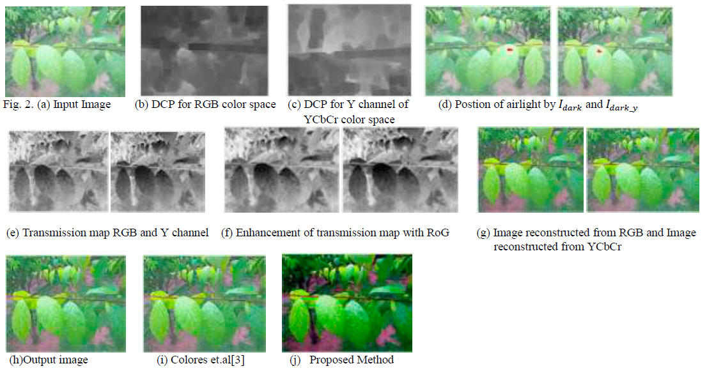
Experiments & Result(cont.)
Result Analysis:
Qualitative Analysis :

Slide 14
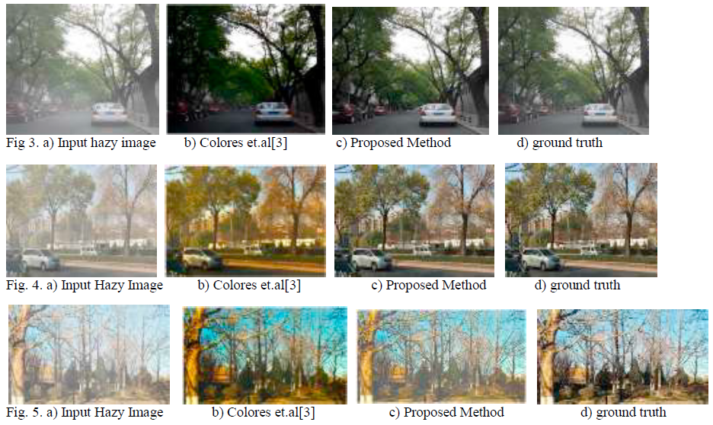
Experiments & Result(cont.)
Colores et.al[3] result is haze free but it’s color
contrast is high and edges are not clear as in the
reference image. Images obtained from the
proposed method. From the qualitative assessment,
it is clear that the result of the proposed method
appear to be realistic, visually pleasing and almost
similar to the ground truth image.

Slide 15
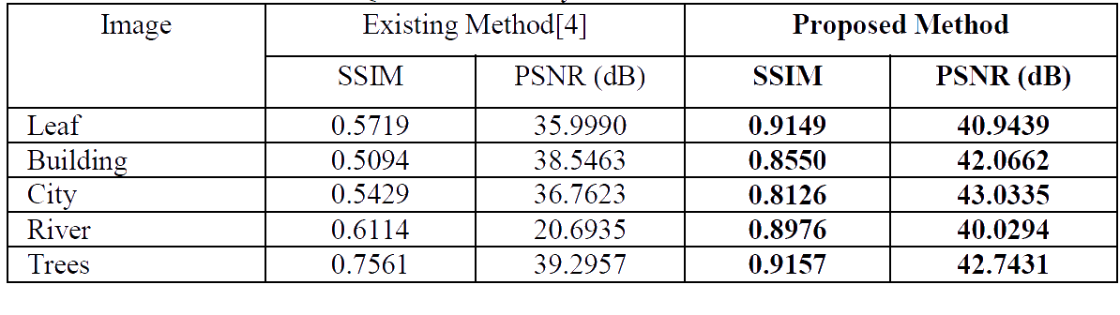
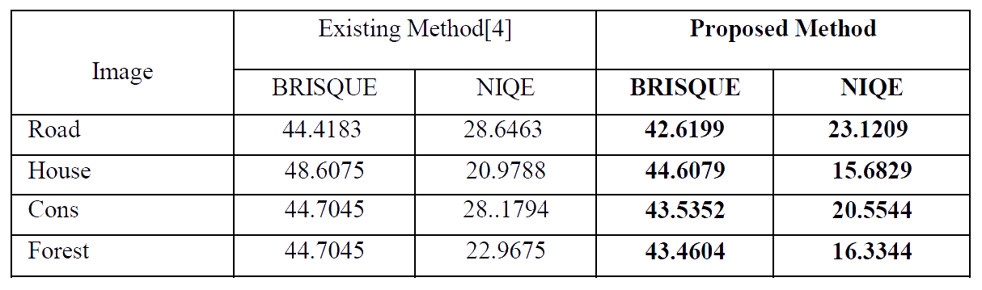
Experiments & Result(cont.)
Quantitative Analysis: We have performed the quantitative analysis in two ways. In the first case, test is conducted with the images where reference images or ground truth images are available and in the second case, where the reference images are not known or available.
When ground truth images are present When ground truth images are not present

Slide 16
Conclusion
Usually the natural weather conditions such as haze or fog hinder the visibility and aesthetic view of a scene.
An improved image dehazing system has been proposed exploring the concept of improved Dark Channel Prior (DCP) and Relativity of Gaussian (RoG). This method calculates the transmission map and applied Relativity of Gaussian and Guided filter to enhance the transmission map.
This work provides good performance for the task of obtaining haze-less image both qualitative and quantitative manner.
Experimental results show that the proposed method estimates haze more accurately, the reconstruct the images are more realistic and detailed information is restored.

Slide 17
YOU
THANK

